Slide 1
CS421 Project Presentation
G1 Group 3
Lim Ji Wei | Thean Zhi Wei | Adrien Bekker

Slide 2
Phase 1
Problem
Data Manipulation
Dimensionality Reduction
Model Selection
Methodology
Pivot Table
Tried three different imputation methods
Mean, median, -1
PCA Analysis
Tried three models
Logistic Regression, Multilayer Perceptron, K-Nearest Neighbors

Slide 3
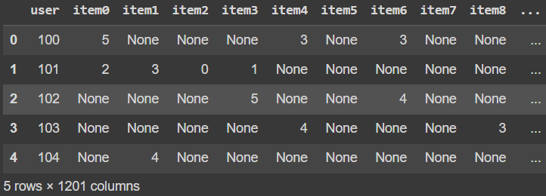
Choosing the model
Pivot Table
Row represents unique user
Column represents unique item rating
Standardization
Places more emphasis on extremes (0s and 5s)
Imputed with -1 to emphasize not rated
Models
Logistic Regression
.5868 AUC
Neural Network
Chose number of epochs by iterating from 1-1000 epochs
Chose number of layers by adding layers and observing the AUC changes
.6089
KNN:
Iterated from 1-100 neighbors
.7562 AUC

Slide 4
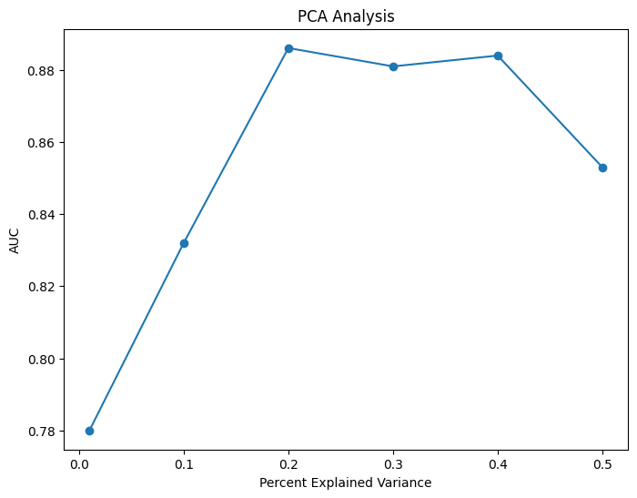
PCA Analysis and Final Result
PCA and KNN
Dimensionality reduction
Measures explained variance
Elbow point to filter out most important components (.2%)
Iterated through 1-100 neighbors
.8861 AUC with 40 neighbors
Result
.5507 AUC
Small dataset = small test set
Random distribution of test set does not represent distribution of unseen data
Large number of features (92 principal components) allowed for overfitting with such a simple model

Slide 5
Phase 2
Problem
Unbalanced dataset
Combining Phase 1 & Phase 2 datasets
2000 normal users
200 anomalous users
Methodology
Rebalance dataset using:
Sklearn Resample
Imblearn SMOTE
Balanced Bagging Classifier

Slide 6
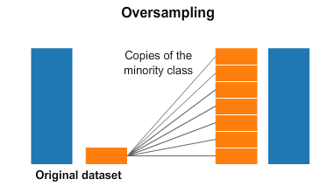
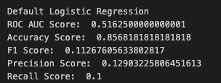
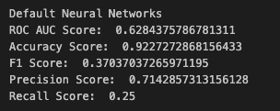
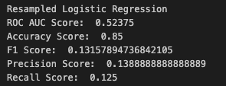
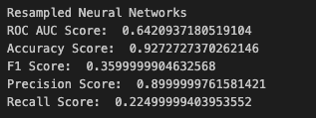
Rebalancing
Use of oversampling to rebalance the dataset
Duplicates random records from the minority class
Increase number of records in minority class to be the same as that of the majority class
Use of the resample function from sklearn
Logistic Regression
Neural Networks

Slide 7
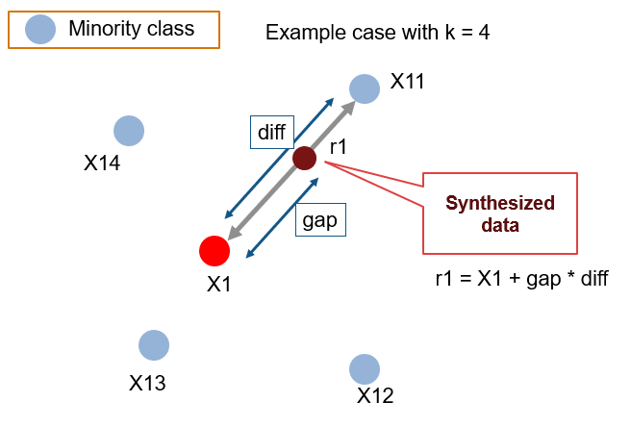
SMOTE
Synthetic Minority Oversampling Technique (SMOTE)
Generates synthetic records from the minority class
Generate new instances with the help of interpolation between the instances that lie together.
How does it work?
A minority class data point is selected at random
KNN’s for the minority data point is selected (i.e. k = 4)
n of these k neighbours are chosen to interpolate new synthetic instances
n depends on the amount of oversampling required, oversampling of 300% means n = 3
For each of the n neighbours, the difference between the original point and the neighbour is calculated and multiplied by a random number between 0 and 1.
This gives us a synthetic example along the line between the two points.

Slide 8
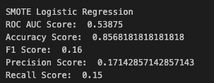
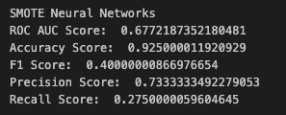
SMOTE
Synthetic Minority Oversampling Technique (SMOTE)
Generates synthetic records from the minority class
Generate new instances with the help of interpolation between the instances that lie together.
Logistic Regression
Neural Networks

Slide 9
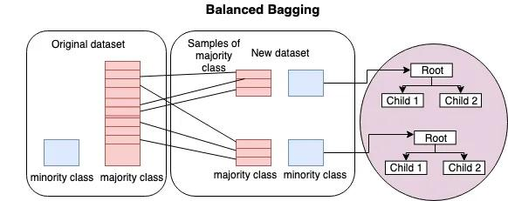
Balanced Bagging Classifier
An ensemble method that trains multiple classifiers on different subsets of the training data and combines their predictions.
Addresses the problem of imbalanced data by using random under sampling to balance the class distribution in each subset.
Reduce the bias towards the majority class and improve the performance on the minority class.

Slide 10
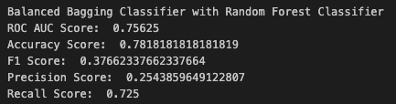
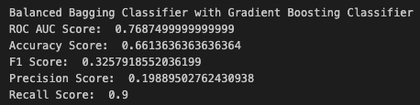
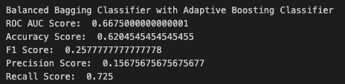
Balanced Bagging Classifier
Classifiers Used
Random Forest
Gradient Boosting
Adaptive Boosting
Constructs a multitude of decision trees at training time and outputting the class that is the mode of the classes (classification) of the individual trees.
Combines several weak learners into strong learners. Each new model is trained to minimize the loss function of the previous model using gradient descent
Iteratively trains weak classifiers on the training dataset with each successive classifier giving more weightage to the data points that are misclassified.

Slide 11
Phase 3
Problem
Low AUC (0.7), features not good
Methodology
Feature engineering
Autoencoder
Ensemble approach to classify each user according to majority
Logistic Regression
KNN classifier
MLP
Random Forest
XGBoost
Isolation Forest
Local Outlier Factor

Slide 12
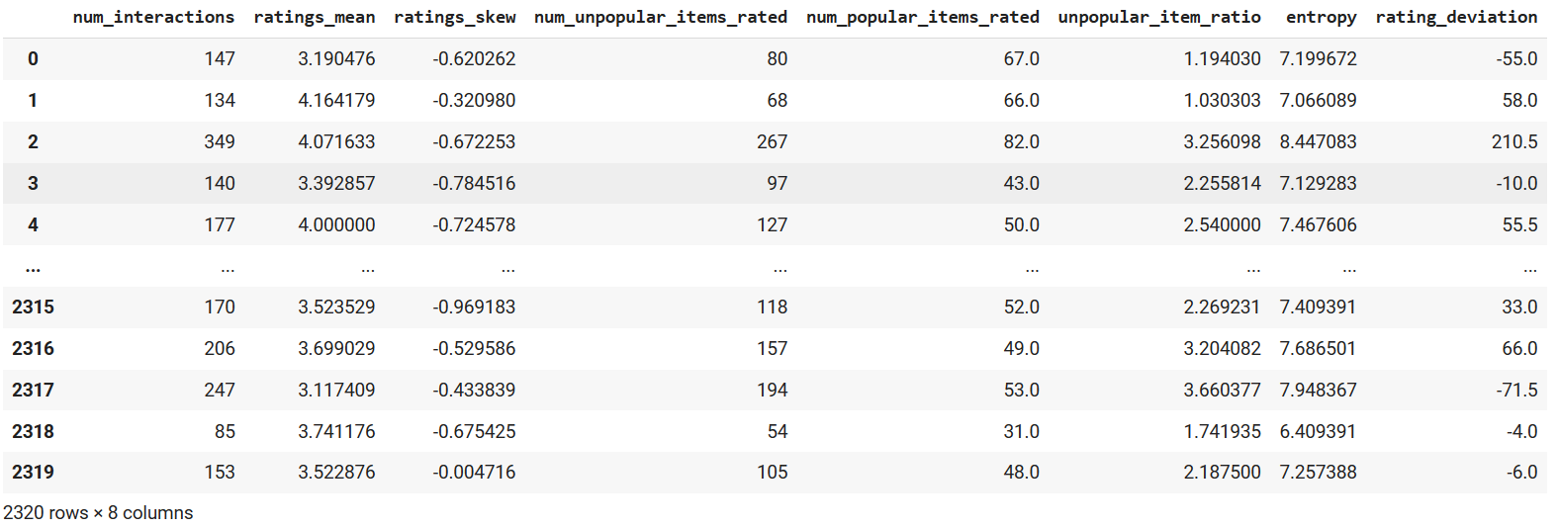
Feature Engineering

Slide 13
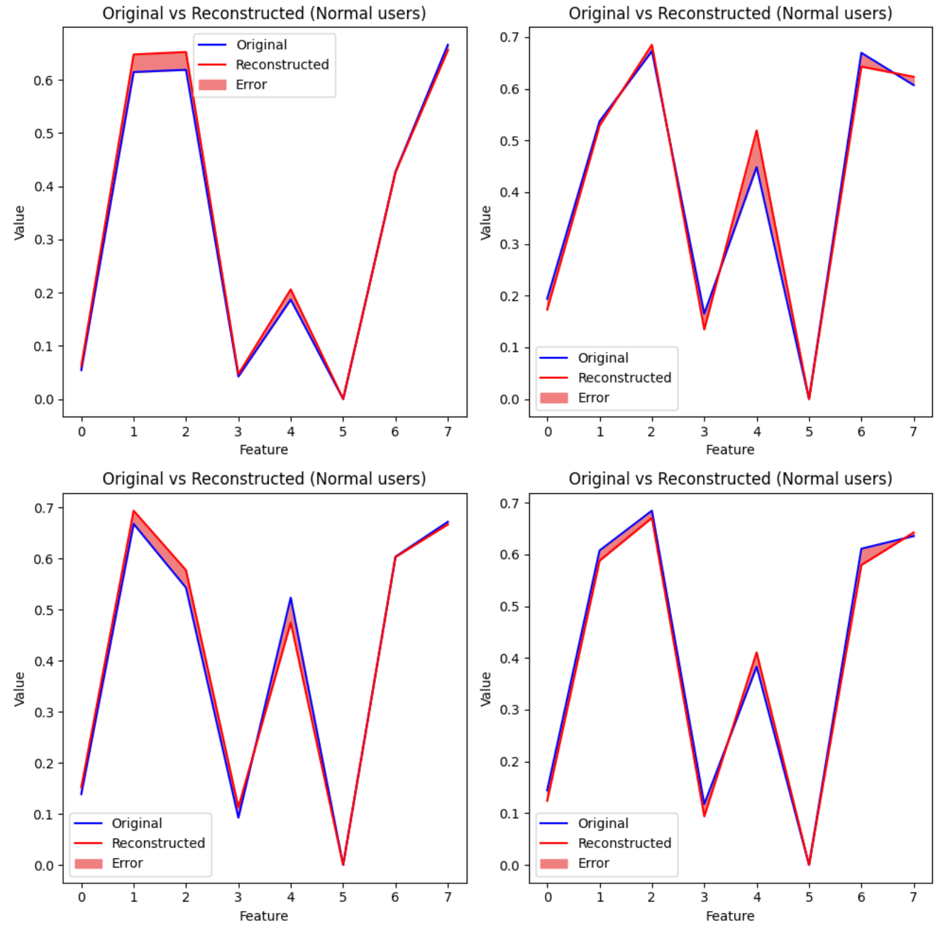
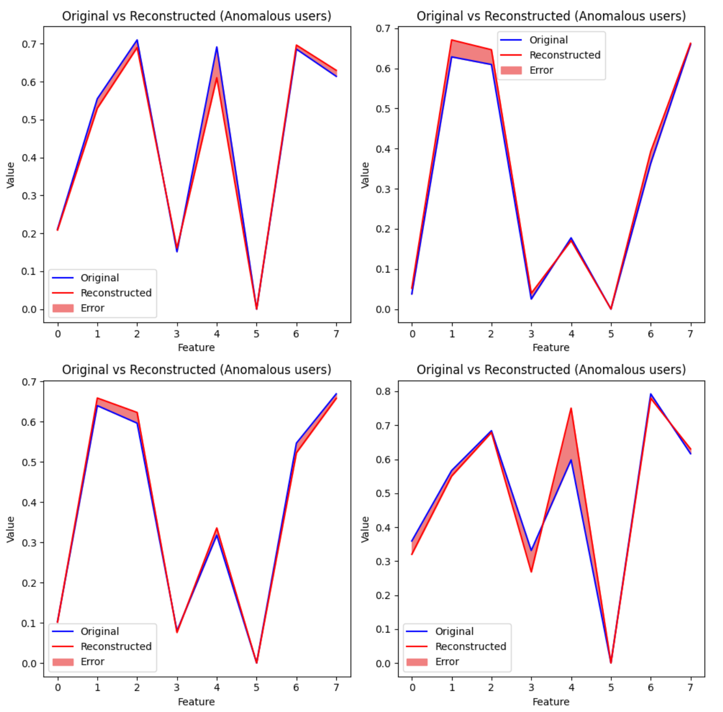
Autoencoder
Train the autoencoder neural network on normal users to learn about normal users’ characteristics.
Training data: Normal users data
Validation data: Normal + anomalous users data to evaluate model's ability to identify distinguish normal and anomalous users

Slide 14
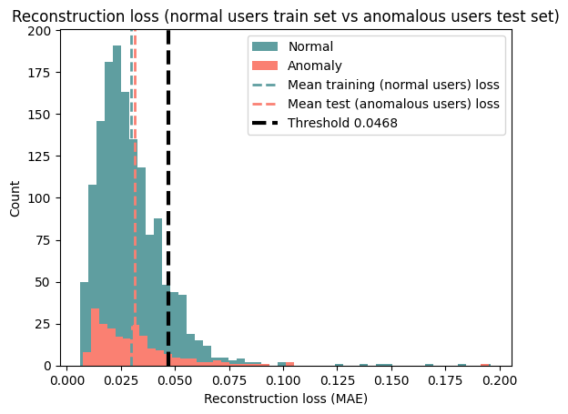
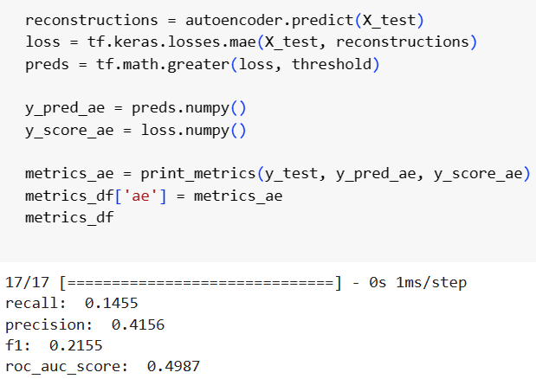
Autoencoder
Low ROC AUC, auto encoder not really used in the ensemble models

Slide 15
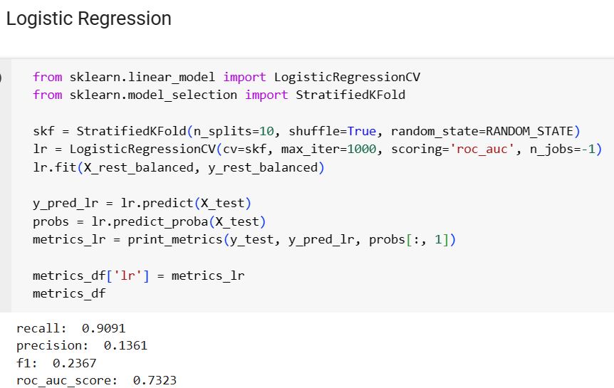
Logistic Regression
Train Logistic Regression on train set with oversampled (random over sampling) anomalous users

Slide 16
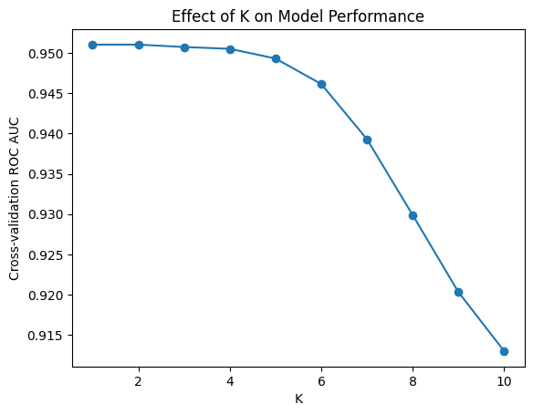
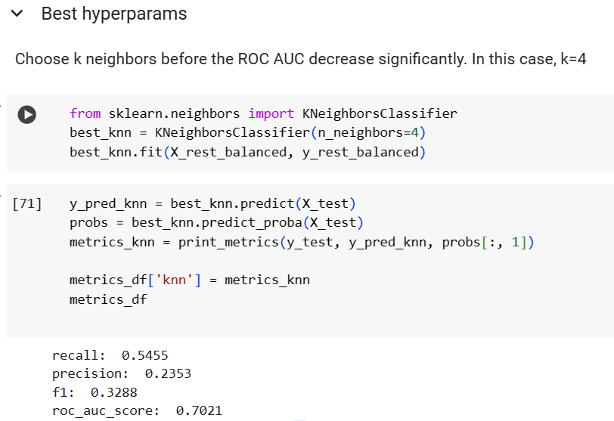
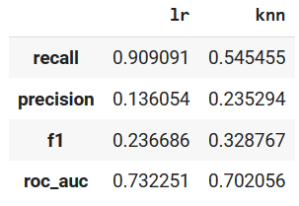
KNN Classifier
k=4 before ROC AUC decreases

Slide 17
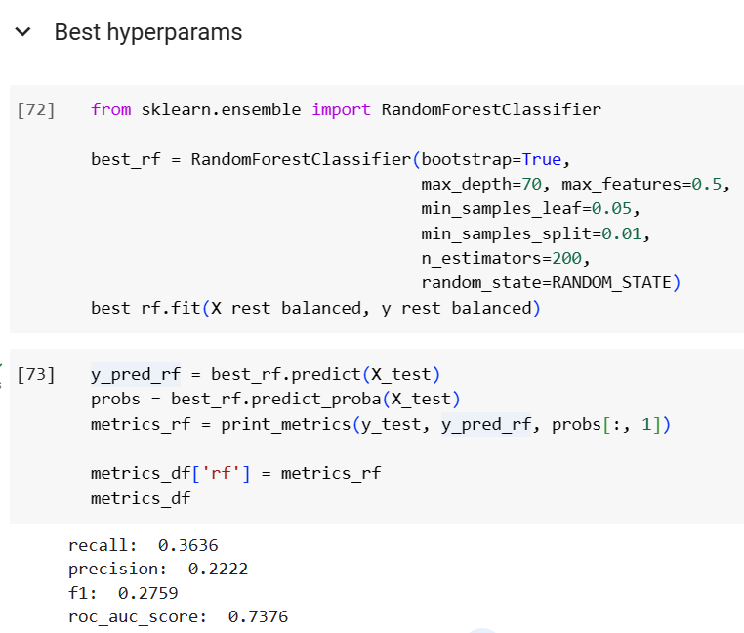
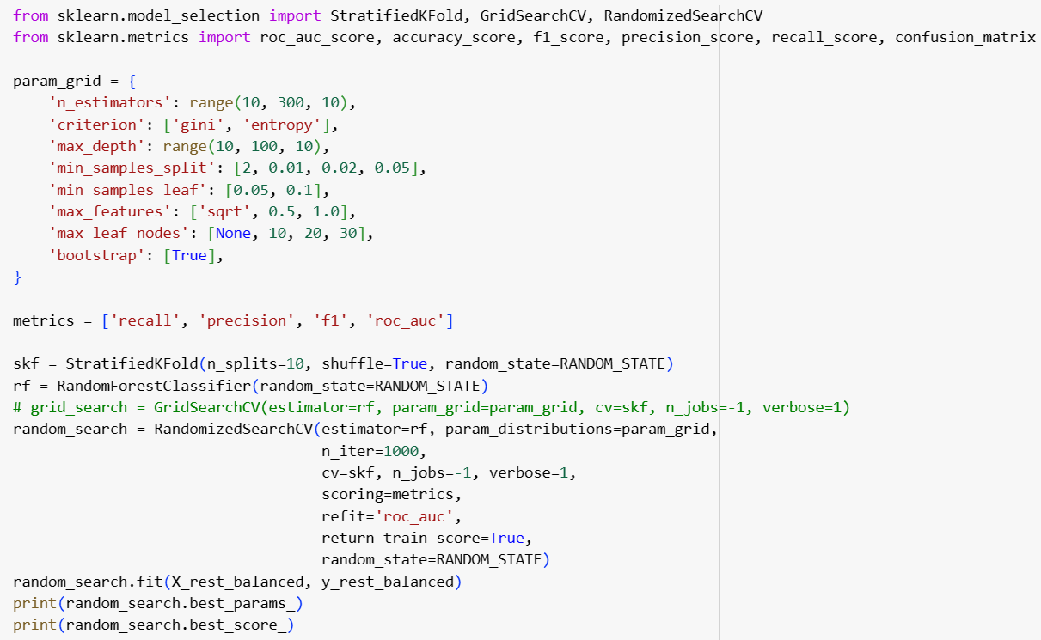
Random Forest
Use RandomizedSearchCV for quicker hyperparameter tuning

Slide 18
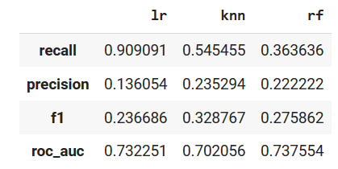
Random Forest

Slide 19
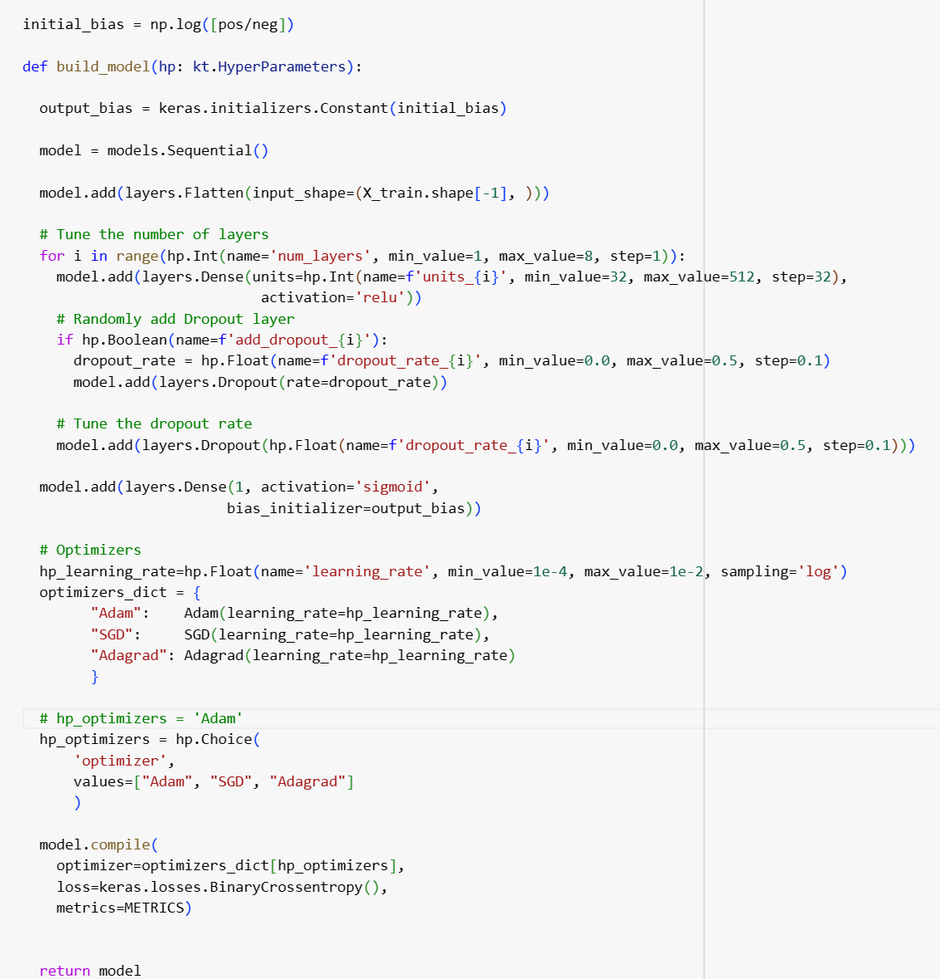
Hypertune MLP with Keras Tuner
Create a function returns a neural network with hyperparameters to try in the function

Slide 20
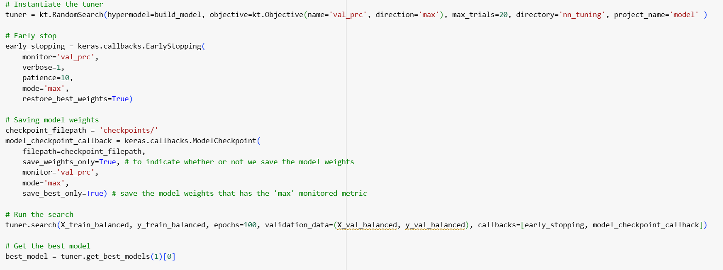
Hypertune MLP with Keras Tuner
Run the hyperparameters search, early stopping if AUC for precision-recall curve does not increase after 10 epochs

Slide 21
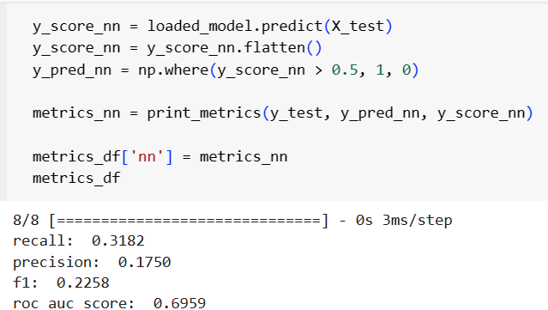
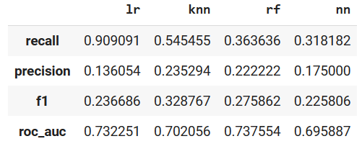
Hypertune MLP with Keras Tuner
Save and load the model to evaluate on test set

Slide 22
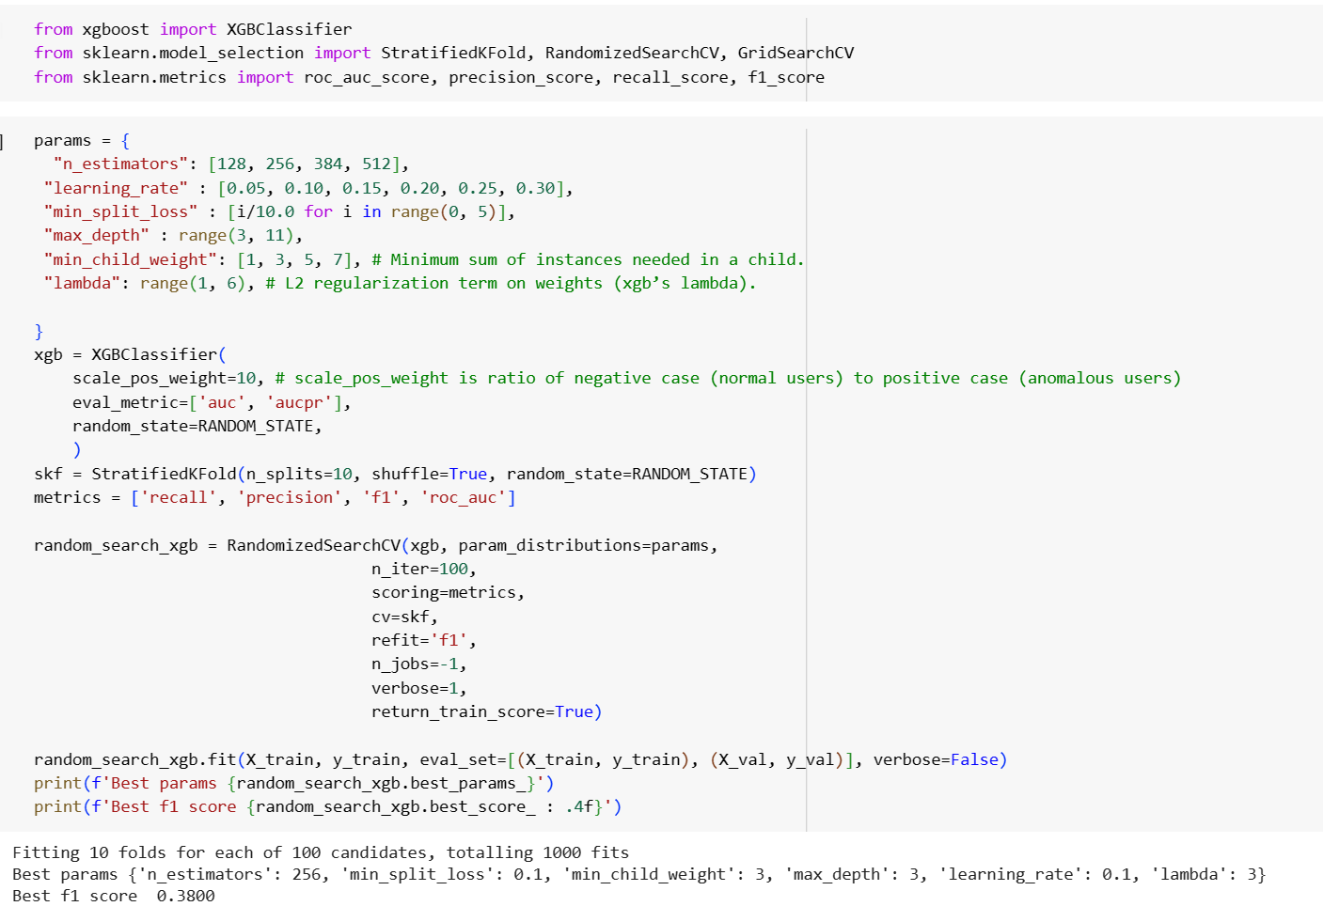
XGBoost
Use RandomizedSearchCV for quicker hyperparameter tuning

Slide 23
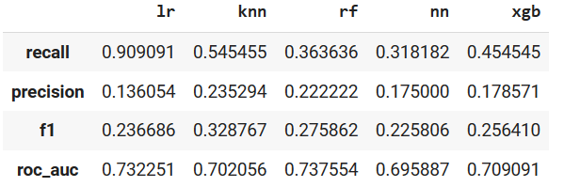
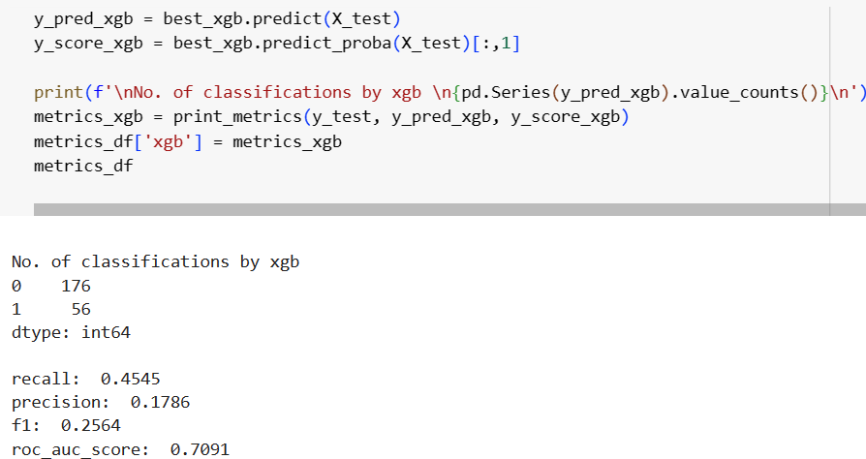
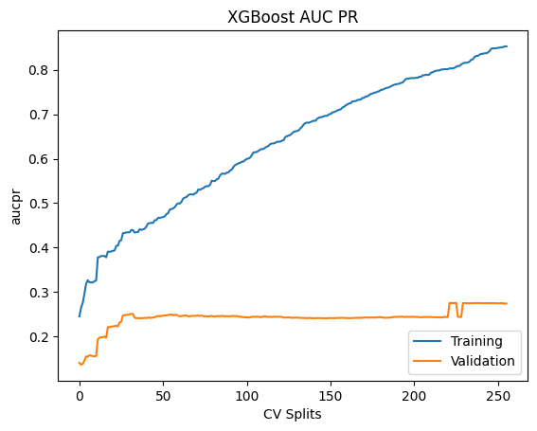
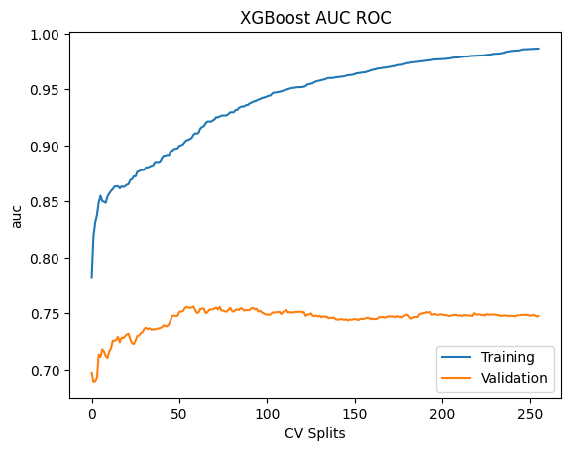
XGBoost
XGBoost overfitting

Slide 24
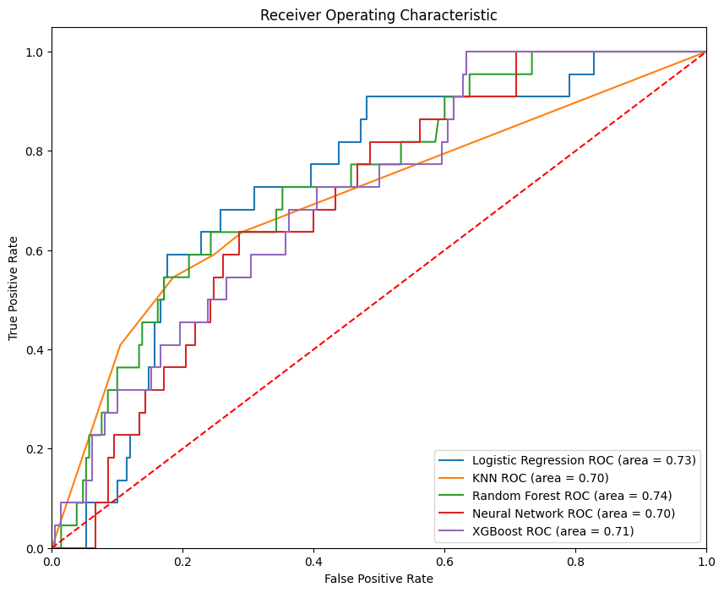
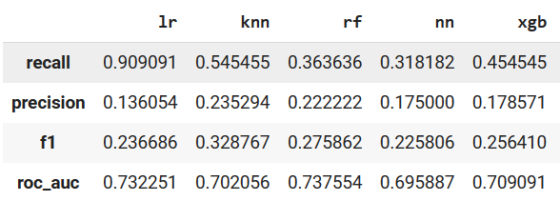
Performance Summary

Slide 25
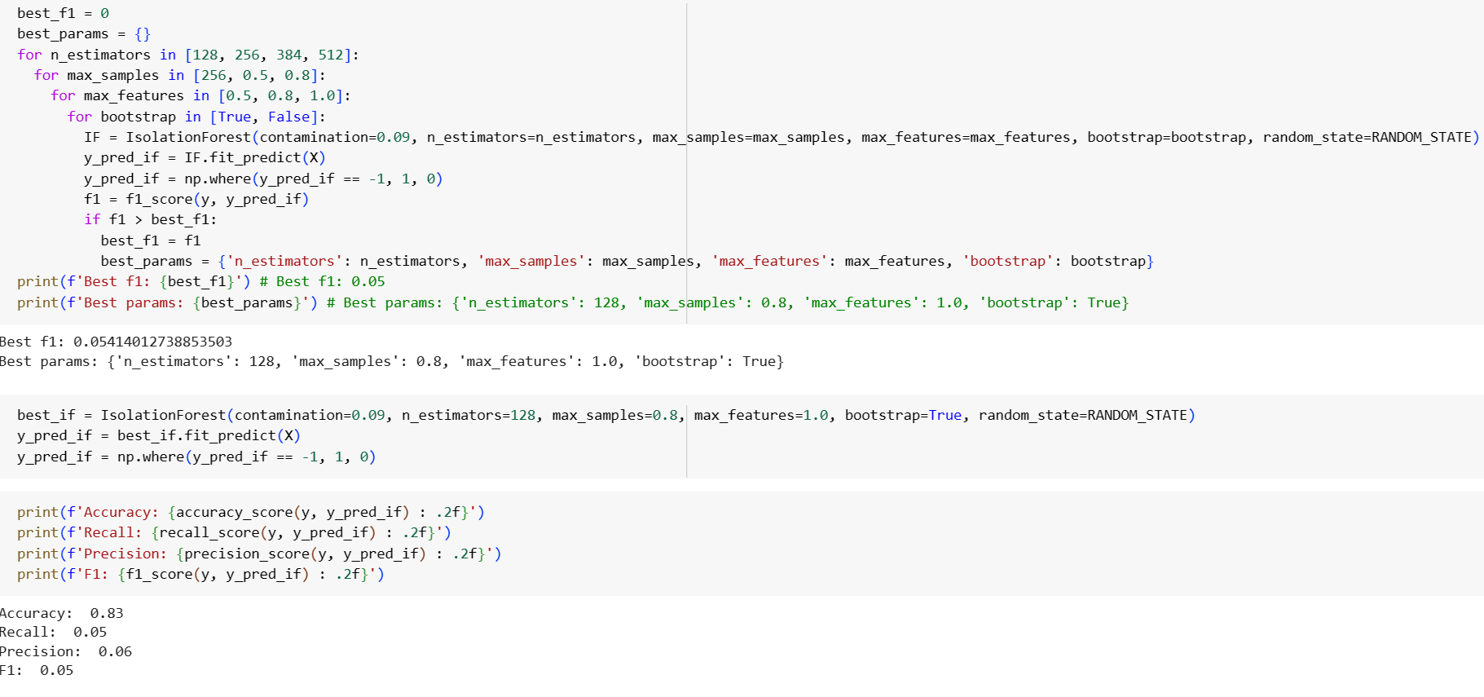
Isolation Forest
Isolation forest is poor in identifying anomalies based on the features we have. Exclude isolation forest's predictions from the ensemble models.

Slide 26
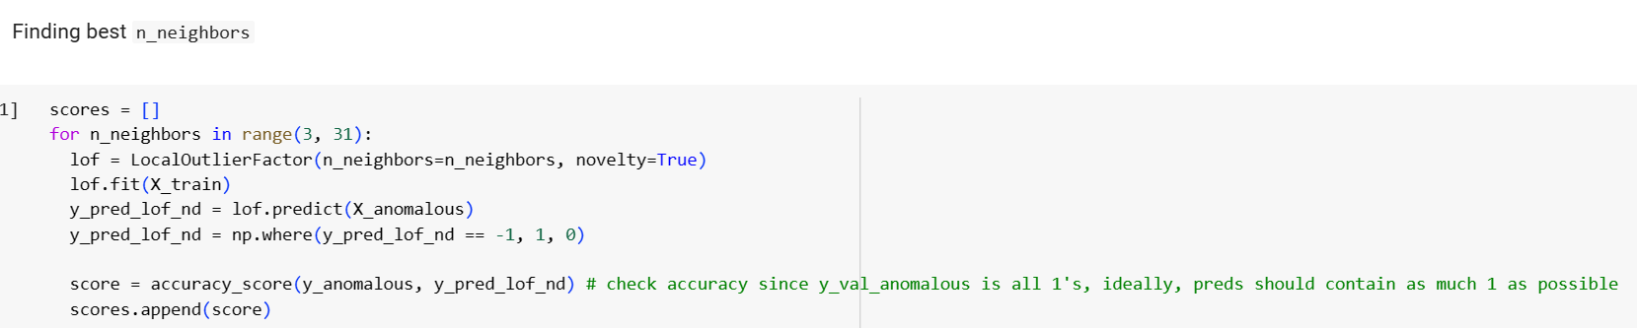
Local Outlier Factor (LOF) Novelty Detection
Approach: As we have labels (normal or anomalous) for our data, we can use LOF for novelty detection.
fit the LOF model (novelty=True) on only normal users,
tune the n_neighbors hyperparameter to maximise the accuracy score on test set (all anomalous users)

Slide 27
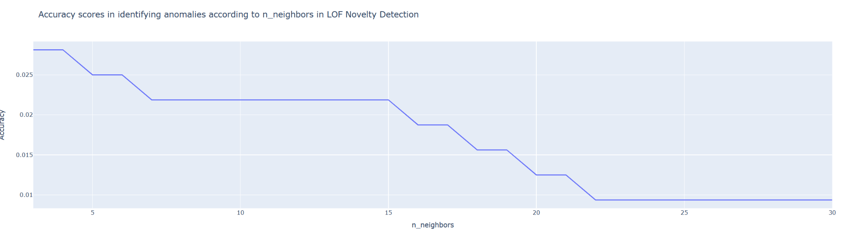
Local Outlier Factor (LOF) Novelty Detection
The accuracy is very poor. LOF novelty detection does not perform well in identifying anomalies from our features.

Slide 28
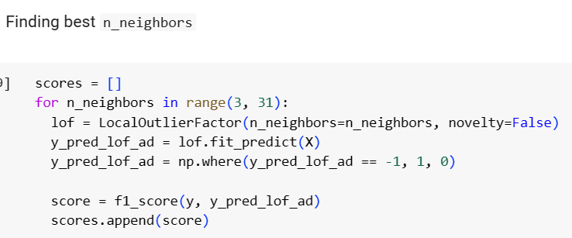
Local Outlier Factor (LOF) Outlier Detection
Approach: Use LOF as outlier detection. As LOF is an unsupervised method but since we have labelled data (normal or anomalous user),
fit the LOF model on entire train set (including both normal and anomalous users)
tune n_neighbors that maximises f1 score on the val set
use the best LOF model (whose n_neighbors have the highest f1 score) 's predictions as part of the voting for lof_ad model in the ensemble approach.

Slide 29
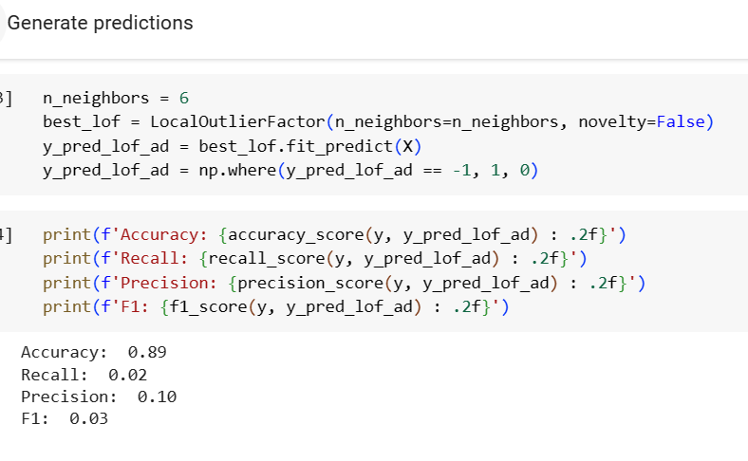
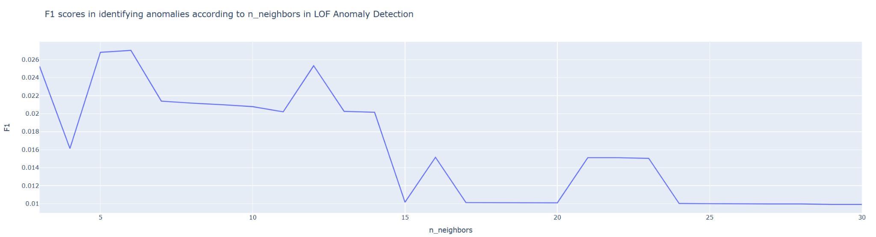
Local Outlier Factor (LOF) Outlier Detection
Using LOF outlier detection does not perform well in identifying anomalies based on the features we have. Exclude lof_od's predictions from the ensemble models.

Slide 30
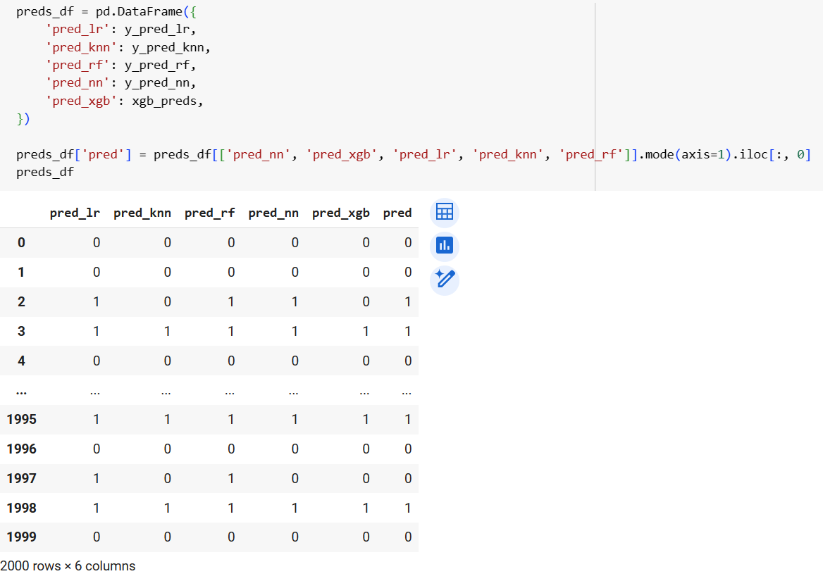
Ensemble Approach (Majority voting)
Classify user according to the majority classification from supervised models

Slide 31
Summary
Phase 1 | Used each item as a feature (1100+ column features) KNN classifier on PCA components
Phase 2 | Oversampling with existing data Oversampling with synthetic data (SMOTE) Balanced Bagging Classifier
Phase 3 | Feature engineering Autoencoders Ensemble approach to classify each user according to majority

